Slide 1

CSCE883 Machine Learning
Lecture 2 SL+KNN+Bayes
Jianjun Hu
Department of Computer Science & Engineering
University of South Carolina

Slide 2
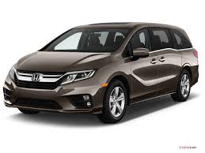
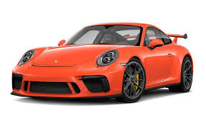
Learning a Class from Examples
Class C of a “family car”
  Prediction: Is car x a family car?
Input representation:
x₁: price, x₂ : engine power
Output:
  Positive (+) and negative (–) examples

Slide 3
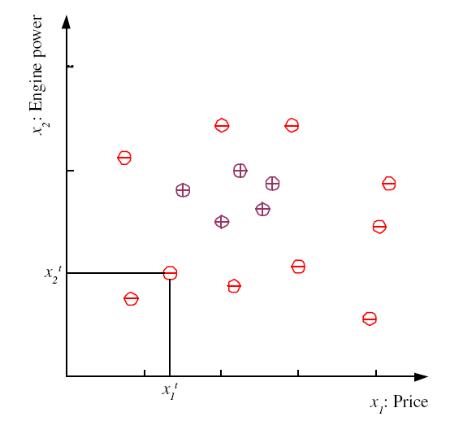
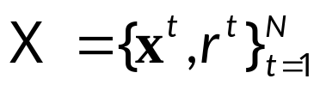
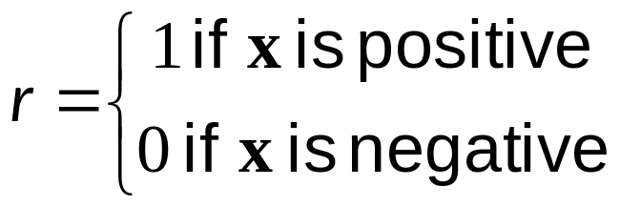
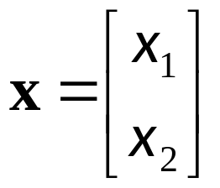
Training set X

Slide 4
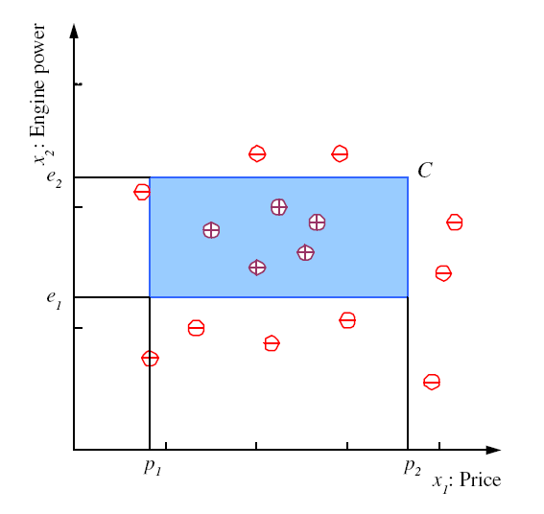
Class C

Slide 5
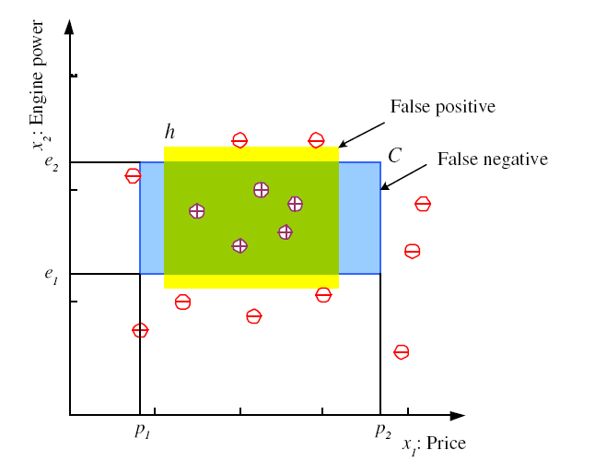
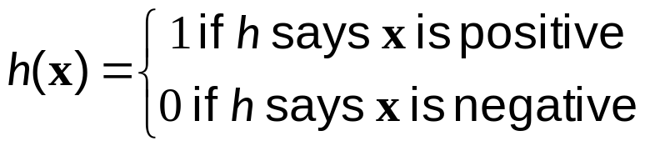
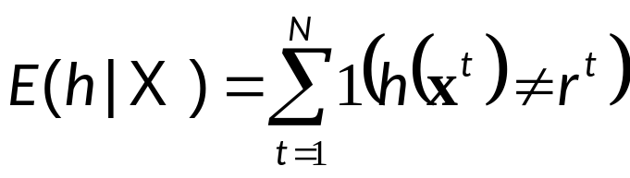
Hypothesis class H
Error of h on H

Slide 6
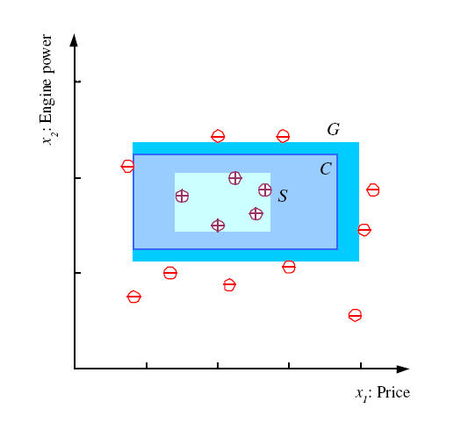
S, G, and the Version Space
most specific hypothesis, S
most general hypothesis, G
h ∈ H, between S and G is
consistent and make up the
version space
(Mitchell, 1997)

Slide 7
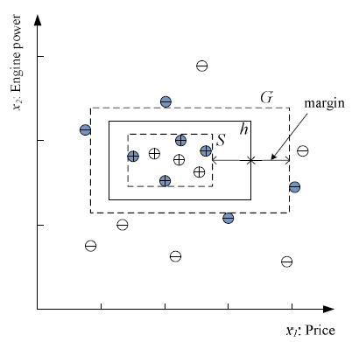
Margin
Choose h with largest margin

Slide 8
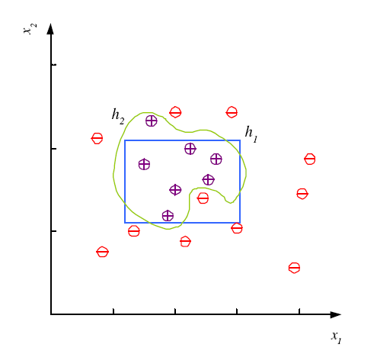
Noise and Model Complexity
Use the simpler one because
Simpler to use
(lower computational
complexity)
Easier to train (lower
space complexity)
Easier to explain
(more interpretable)
Generalizes better (lower
variance - Occam’s razor)

Slide 9
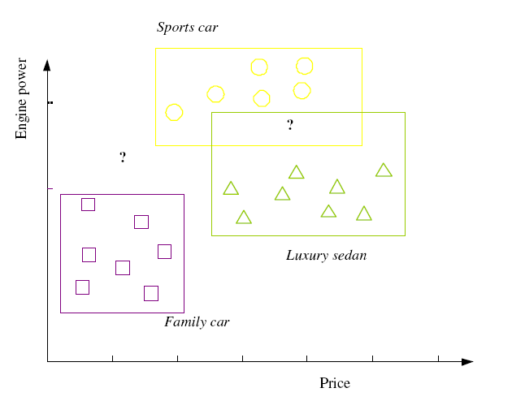
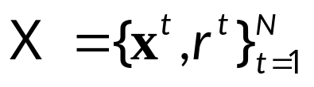
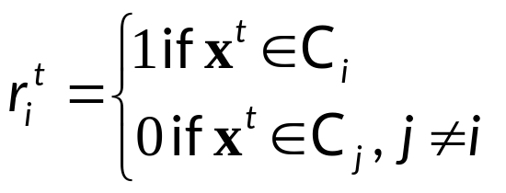

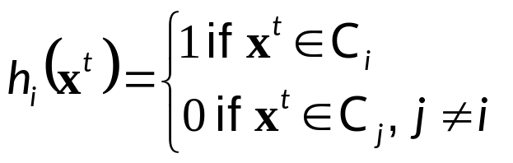
Multiple Classes, C_{i} i=1,...,K
Train hypotheses
h_{i}(x), i =1,...,K:
[0.1, 0.3, 0.5….] [1, 0, 0, 0]
[0.3, 0.4, 0.5…] [0, 1, 0, 0]

Slide 10
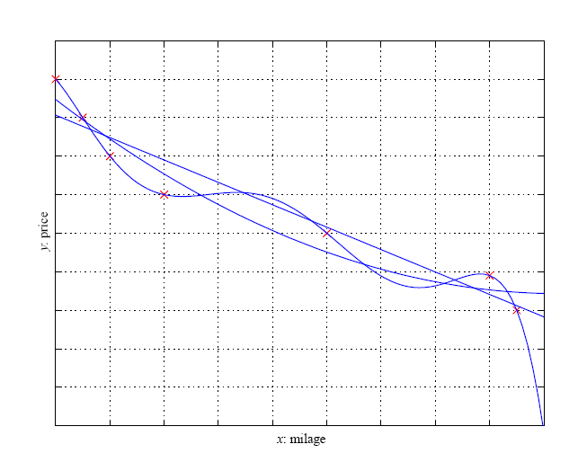
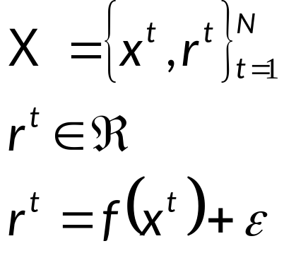


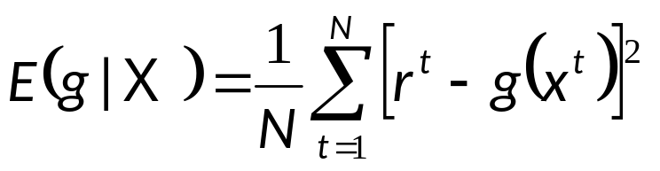
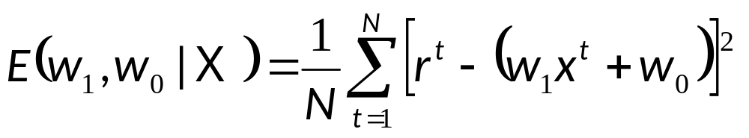
Regression

Slide 11

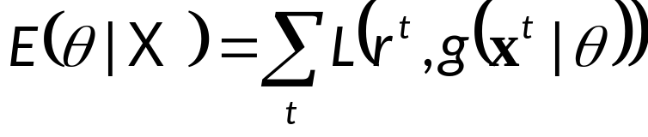
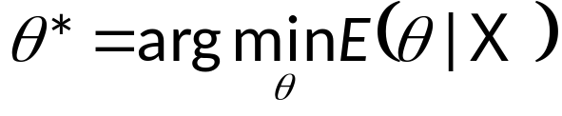
Dimensions of a Supervised Learner
Model:
Loss function:
Optimization procedure:

Slide 12
K-Nearest Neighbor Classifiers

Slide 13

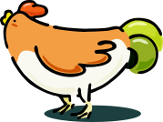


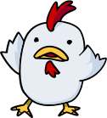

Nearest Neighbor Classifiers
Basic idea:
  If it walks like a duck, quacks like a duck, then it’s probably a duck
Compute Distance
Test Record
Training Records
Choose k of the “nearest” records

Slide 14

Nearest neighbor method
Majority vote within the k nearest neighbors
new
K= 1: brown
K= 3: green

Slide 15
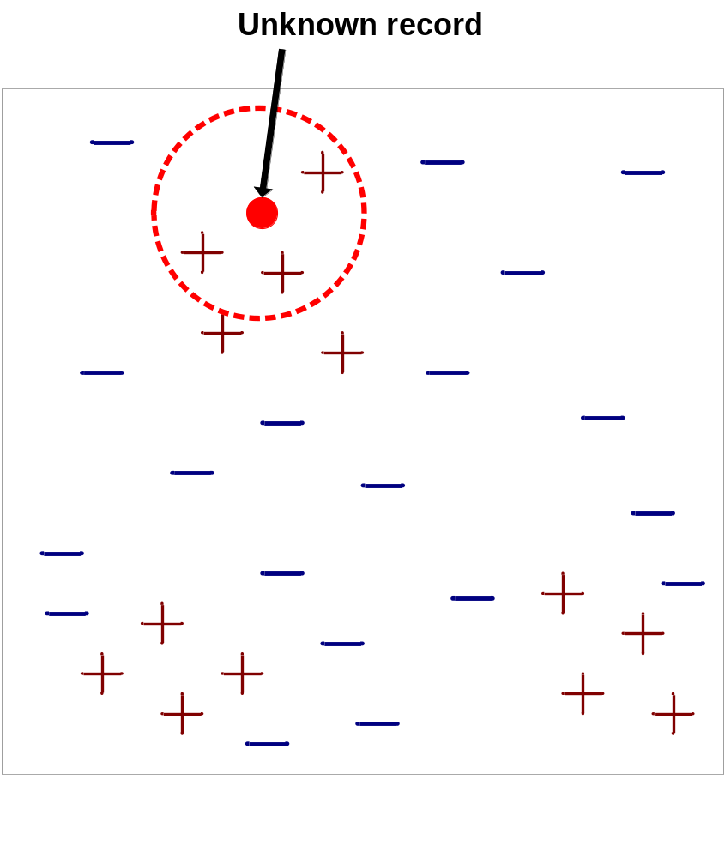
Nearest-Neighbor Classifiers
Requires three things
  The set of stored records
  Distance Metric to compute distance between records
  The value of k, the number of nearest neighbors to retrieve
To classify an unknown record:
  Compute distance to other training records
  Identify k nearest neighbors
  Use class labels of nearest neighbors to determine the class label of unknown record (e.g., by taking majority vote)

Slide 16
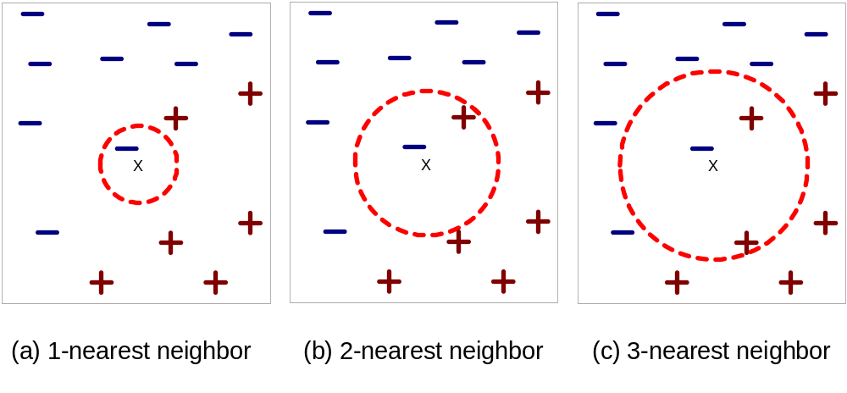
Definition of Nearest Neighbor
K-nearest neighbors of a record x are data points that have the k smallest distance to x

Slide 17
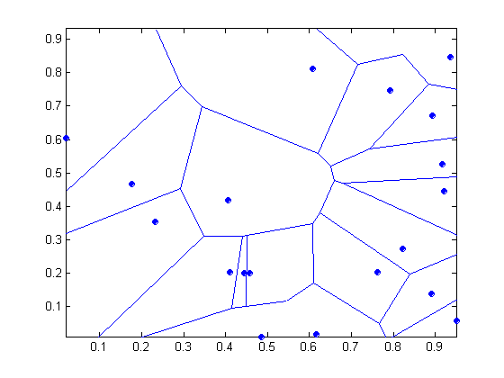
1 nearest-neighbor
Voronoi Diagram

Slide 18
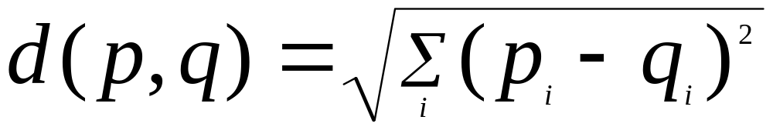
Nearest Neighbor Classification
Compute distance between two points:
  Euclidean distance
Determine the class from nearest neighbor list
  take the majority vote of class labels among the k-nearest neighbors
  Weigh the vote according to distance
    weight factor, w = 1/d²

Slide 19
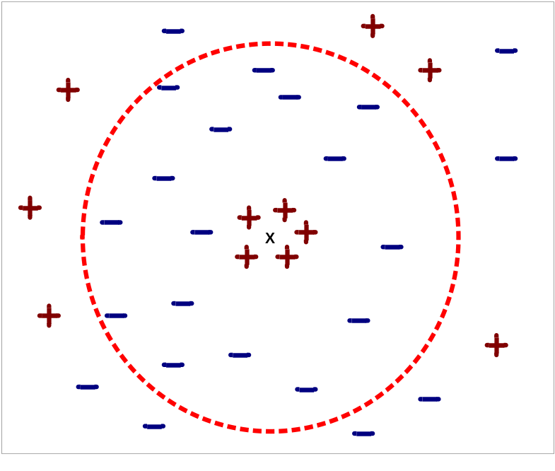
Nearest Neighbor Classification…
Choosing the value of k:
  If k is too small, sensitive to noise points
  If k is too large, neighborhood may include points from other classes

Slide 20
Nearest Neighbor Classification…
Scaling issues
  Attributes may have to be scaled to prevent distance measures from being dominated by one of the attributes
  Example:
    height of a person may vary from 1.5m to 1.8m
    weight of a person may vary from 90lb to 300lb
    income of a person may vary from $10K to $1M

Slide 21
Nearest Neighbor Classification…
Problem with Euclidean measure:
  High dimensional data
    curse of dimensionality
  Can produce counter-intuitive results
1 1 1 1 1 1 1 1 1 1 1 0
1 0 0 0 0 0 0 0 0 0 0 0
vs
0 1 1 1 1 1 1 1 1 1 1 1
0 0 0 0 0 0 0 0 0 0 0 1
d = 1.4142
d = 1.4142
    Solution: Normalize the vectors to unit length

Slide 22
Nearest neighbor Classification…
k-NN classifiers are lazy learners
  It does not build models explicitly
  Unlike eager learners such as decision tree induction and rule-based systems
  Classifying unknown records are relatively expensive

Slide 23
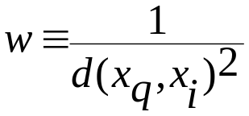
Discussion on the k-NN Algorithm
The k-NN algorithm for continuous-valued target functions
  Calculate the mean values of the k nearest neighbors
Distance-weighted nearest neighbor algorithm
  Weight the contribution of each of the k neighbors according to their distance to the query point x_{q}
    giving greater weight to closer neighbors
  Similarly, for real-valued target functions
Robust to noisy data by averaging k-nearest neighbors
Curse of dimensionality: distance between neighbors could be dominated by irrelevant attributes.
  To overcome it, axes stretch or elimination of the least relevant attributes.

Slide 24
Lazy vs. Eager Learning
Lazy vs. eager learning
  Lazy learning (e.g., instance-based learning): Simply stores training data (or only minor processing) and waits until it is given a test tuple
  Eager learning (the above discussed methods): Given a set of training set, constructs a classification model before receiving new (e.g., test) data to classify
Lazy: less time in training but more time in predicting
Accuracy
  Lazy method effectively uses a richer hypothesis space since it uses many local linear functions to form its implicit global approximation to the target function
  Eager: must commit to a single hypothesis that covers the entire instance space

Slide 25
Lazy Learner: Instance-Based Methods
Instance-based learning:
  Store training examples and delay the processing (“lazy evaluation”) until a new instance must be classified
Typical approaches
  k-nearest neighbor approach
    Instances represented as points in a Euclidean space.
  Locally weighted regression
    Constructs local approximation
  Case-based reasoning
    Uses symbolic representations and knowledge-based inference

Slide 26
Case-Based Reasoning (CBR)
CBR: Uses a database of problem solutions to solve new problems
Store symbolic description (tuples or cases)—not points in a Euclidean space
Applications: Customer-service (product-related diagnosis), legal ruling
Methodology
  Instances represented by rich symbolic descriptions (e.g., function graphs)
  Search for similar cases, multiple retrieved cases may be combined
  Tight coupling between case retrieval, knowledge-based reasoning, and problem solving
Challenges
  Find a good similarity metric
  Indexing based on syntactic similarity measure, and when failure, backtracking, and adapting to additional cases

Slide 27
Naïve Bayes Classifier

Slide 28
Probability and Inference
Result of tossing a coin is ∈ {Heads,Tails}
Random var X ∈{1,0}
Bernoulli: P {X=1} = p_{o}^{X} (1 ‒ p_{o})^{(1 ‒ X)}
Sample: X = {x^{t} }^{N}_{t =1}
Estimation: p_{o} = # {Heads}/#{Tosses} = ∑_{t} x^{t} / N
Prediction of next toss:
Heads if p_{o} > ½, Tails otherwise

Slide 29
Background
There are three methods to establish a classifier
a) Model a classification rule directly
  Examples: k-NN, decision trees, perceptron, SVM
  b) Model the probability of class memberships given input data
  Example: multi-layered perceptron with the cross-entropy cost
c) Make a probabilistic model of data within each class
  Examples: naive Bayes, model based classifiers
a) and b) are examples of discriminative classification
c) is an example of generative classification
b) and c) are both examples of probabilistic classification

Slide 30
Things We’d Like to Do
Spam Classification
  Given an email, predict whether it is spam or not
Medical Diagnosis
  Given a list of symptoms, predict whether a patient has disease X or not
Weather
  Based on temperature, humidity, etc… predict if it will rain tomorrow

Slide 31
Bayesian Classification
Problem statement:
  Given features X₁,X₂,…,X_{n}
  Predict a label Y

Slide 32
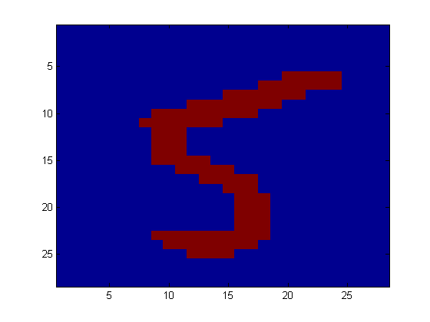
Another Application
Digit Recognition
X₁,…,X_{n} ∈ {0,1} (Black vs. White pixels)
Y ∈ {5,6} (predict whether a digit is a 5 or a 6)
Classifier
5

Slide 33

The Bayes Classifier
A good strategy is to predict:
  (for example: what is the probability that the image represents a 5 given its pixels?)
So … How do we compute that?

Slide 34
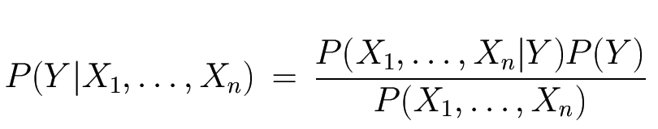
The Bayes Classifier
Use Bayes Rule!
Why did this help? Well, we think that we might be able to specify how features are “generated” by the class label
Likelihood
Prior
Normalization Constant

Slide 35
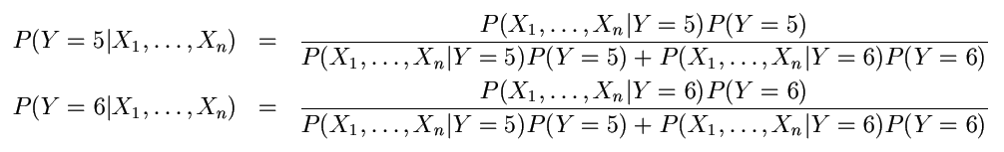
The Bayes Classifier
Let’s expand this for our digit recognition task:
To classify, we’ll simply compute these two probabilities and predict based on which one is greater

Slide 36
Model Parameters
For the Bayes classifier, we need to “learn” two functions, the likelihood and the prior
How many parameters are required to specify the prior for our digit recognition example?

Slide 37
Model Parameters
How many parameters are required to specify the likelihood?
  (Supposing that each image is 30x30 pixels)
  ?

Slide 38
Model Parameters
The problem with explicitly modeling P(X₁,…,X_{n}|Y) is that there are usually way too many parameters:
  We’ll run out of space
  We’ll run out of time
  And we’ll need tons of training data (which is usually not available)

Slide 39
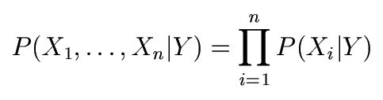
The Naïve Bayes Model
The Naïve Bayes Assumption: Assume that all features are independent given the class label Y
Equationally speaking:
(We will discuss the validity of this assumption later)

Slide 40
Why is this useful?
# of parameters for modeling P(X₁,…,X_{n}|Y):
  2(2^{n}-1)
# of parameters for modeling P(X₁|Y),…,P(X_{n}|Y)
  2n

Slide 41
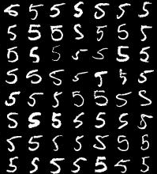
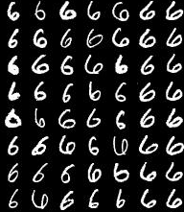
Naïve Bayes Training
Now that we’ve decided to use a Naïve Bayes classifier, we need to train it with some data:
MNIST Training Data

Slide 42
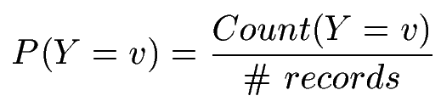

Naïve Bayes Training
Training in Naïve Bayes is easy:
  Estimate P(Y=v) as the fraction of records with Y=v
  Estimate P(X_{i}=u|Y=v) as the fraction of records with Y=v for which X_{i}=u
(This corresponds to Maximum Likelihood estimation of model parameters)

Slide 43
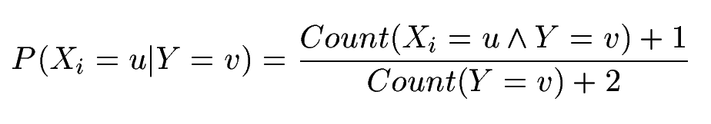
Naïve Bayes Training
In practice, some of these counts can be zero
Fix this by adding “virtual” counts:
  (This is like putting a prior on parameters and doing MAP estimation instead of MLE)
  This is called Smoothing

Slide 44
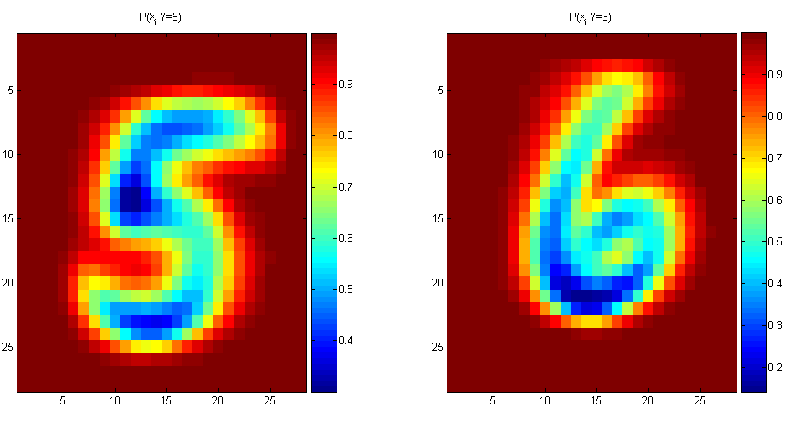
Naïve Bayes Training
For binary digits, training amounts to averaging all of the training fives together and all of the training sixes together.

Slide 45
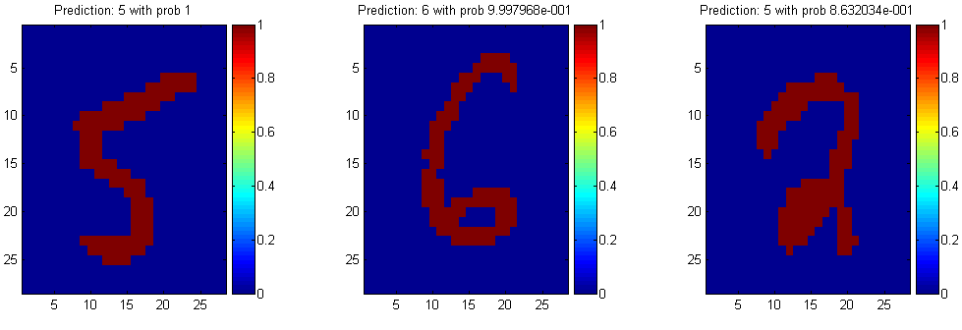
Naïve Bayes Classification

Slide 46
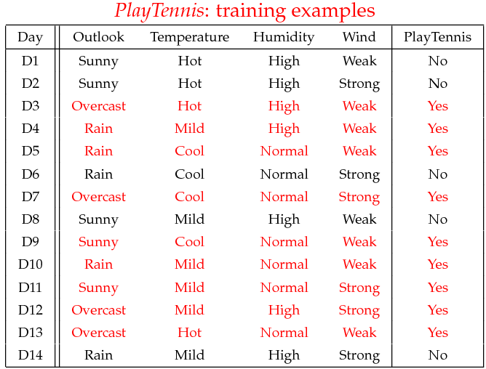
Example
Example: Play Tennis

Slide 47
Example
Learning Phase
Outlook | Play=Yes | Play=No
Sunny | 2/9 | 3/5
Overcast | 4/9 | 0/5
Rain | 3/9 | 2/5
Temperature | Play=Yes | Play=No
Hot | 2/9 | 2/5
Mild | 4/9 | 2/5
Cool | 3/9 | 1/5
Humidity | Play=Yes | Play=No
High | 3/9 | 4/5
Normal | 6/9 | 1/5
Wind | Play=Yes | Play=No
Strong | 3/9 | 3/5
Weak | 6/9 | 2/5
P(Play=Yes) = 9/14
P(Play=No) = 5/14

Slide 48
Example
Test Phase
  Given a new instance,
  x’=(Outlook=Sunny, Temperature=Cool, Humidity=High, Wind=Strong)
  Look up tables
  MAP rule
P(Outlook=Sunny|Play=Yes) = 2/9
P(Temperature=Cool|Play=Yes) = 3/9
P(Huminity=High|Play=Yes) = 3/9
P(Wind=Strong|Play=Yes) = 3/9
P(Play=Yes) = 9/14
P(Outlook=Sunny|Play=No) = 3/5
P(Temperature=Cool|Play==No) = 1/5
P(Huminity=High|Play=No) = 4/5
P(Wind=Strong|Play=No) = 3/5
P(Play=No) = 5/14
P(Yes|x’): [P(Sunny|Yes)P(Cool|Yes)P(High|Yes)P(Strong|Yes)]P(Play=Yes) = 0.0053
P(No|x’): [P(Sunny|No) P(Cool|No)P(High|No)P(Strong|No)]P(Play=No) = 0.0206
Given the fact P(Yes|x’) < P(No|x’), we label x’ to be “No”.

Slide 49
The Naive Bayes Classifier for Data Sets with Numerical Attribute Values
One common practice to handle numerical attribute values is to assume normal distributions for numerical attributes.

Slide 50
The numeric weather data with summary statistics
outlook |  |  | temperature |  |  | humidity |  |  | windy |  |  | play
 | yes | no |  | yes | no |  | yes | no |  | yes | no | yes | no
sunny | 2 | 3 |  | 83 | 85 |  | 86 | 85 | false | 6 | 2 | 9 | 5
overcast | 4 | 0 |  | 70 | 80 |  | 96 | 90 | true | 3 | 3
rainy | 3 | 2 |  | 68 | 65 |  | 80 | 70
 |  |  |  | 64 | 72 |  | 65 | 95
 |  |  |  | 69 | 71 |  | 70 | 91
 |  |  |  | 75 |  |  | 80
 |  |  |  | 75 |  |  | 70
 |  |  |  | 72 |  |  | 90
 |  |  |  | 81 |  |  | 75
sunny | 2/9 | 3/5 | mean | 73 | 74.6 | mean | 79.1 | 86.2 | false | 6/9 | 2/5 | 9/14 | 5/14
overcast | 4/9 | 0/5 | std dev | 6.2 | 7.9 | std dev | 10.2 | 9.7 | true | 3/9 | 3/5
rainy | 3/9 | 2/5

Slide 51
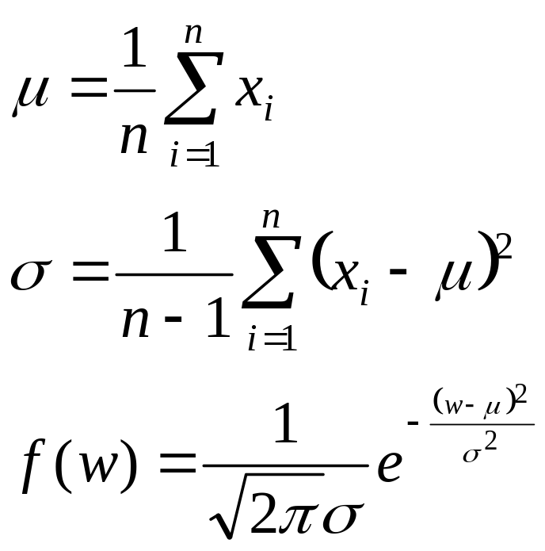
Let x₁, x₂, …, x_{n} be the values of a numerical attribute in the training data set.

Slide 52
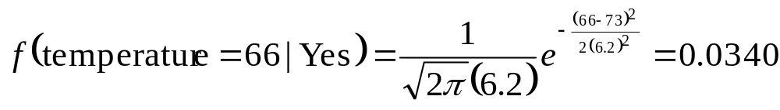
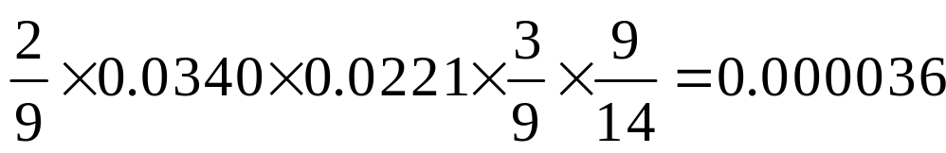
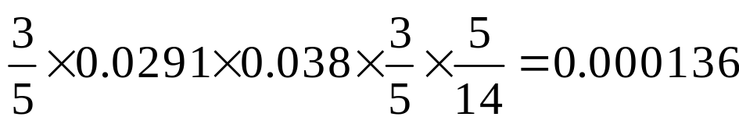
For examples,
Likelihood of Yes =
Likelihood of No =

Slide 53
Outputting Probabilities
What’s nice about Naïve Bayes (and generative models in general) is that it returns probabilities
  These probabilities can tell us how confident the algorithm is
  So… don’t throw away those probabilities!

Slide 54
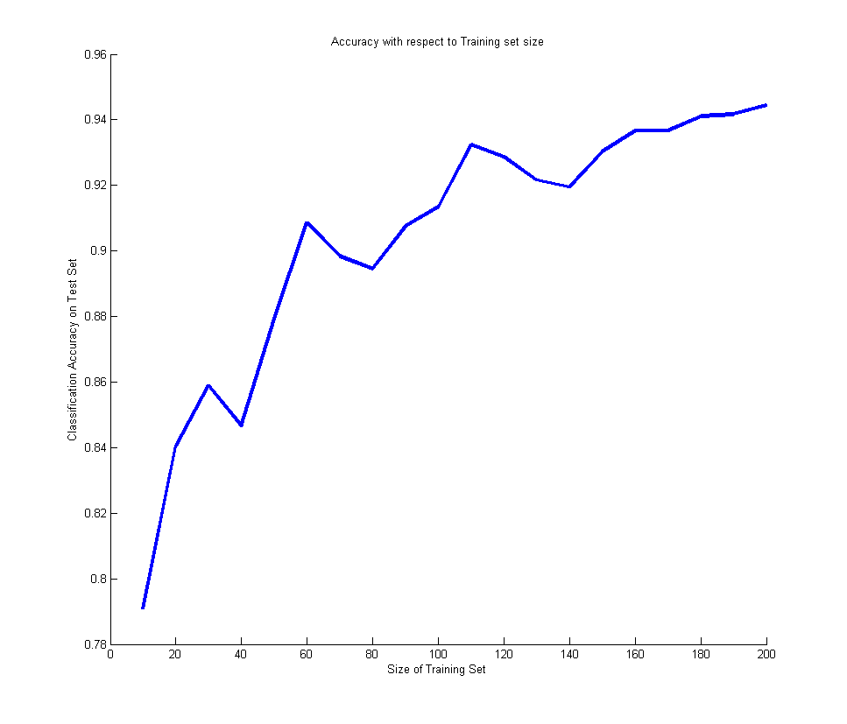
Performance on a Test Set
Naïve Bayes is often a good choice if you don’t have much training data!

Slide 55
Naïve Bayes Assumption
Recall the Naïve Bayes assumption:
  that all features are independent given the class label Y
Does this hold for the digit recognition problem?

Slide 56
Exclusive-OR Example
For an example where conditional independence fails:
  Y=XOR(X₁,X₂)
X₁ | X₂ | P(Y=0|X₁,X₂) | P(Y=1|X₁,X₂)
0 | 0 | 1 | 0
0 | 1 | 0 | 1
1 | 0 | 0 | 1
1 | 1 | 1 | 0

Slide 57
Actually, the Naïve Bayes assumption is almost never true
Still… Naïve Bayes often performs surprisingly well even when its assumptions do not hold

Slide 58
Numerical Stability
It is often the case that machine learning algorithms need to work with very small numbers
  Imagine computing the probability of 2000 independent coin flips
  MATLAB thinks that (.5)²⁰⁰⁰=0

Slide 59
Underflow Prevention
Multiplying lots of probabilities
➔ floating-point underflow.
Recall: log(xy) = log(x) + log(y),
➔ better to sum logs of probabilities rather than multiplying probabilities.

Slide 60
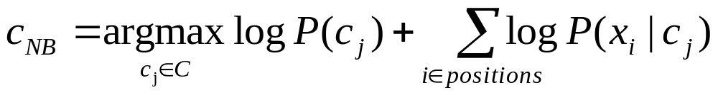
Underflow Prevention
Class with highest final un-normalized log probability score is still the most probable.

Slide 61
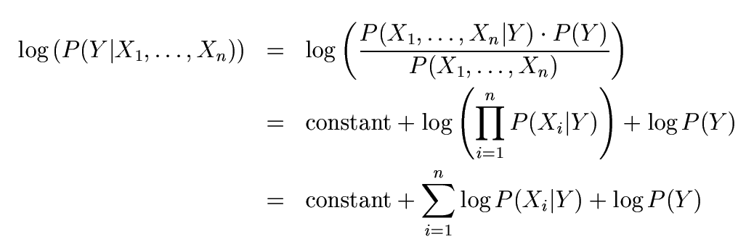
Numerical Stability
Instead of comparing P(Y=5|X₁,…,X_{n}) with P(Y=6|X₁,…,X_{n}),
  Compare their logarithms

Slide 62


Recovering the Probabilities
What if we want the probabilities though??
Suppose that for some constant K, we have:
  And
How would we recover the original probabilities?

Slide 63

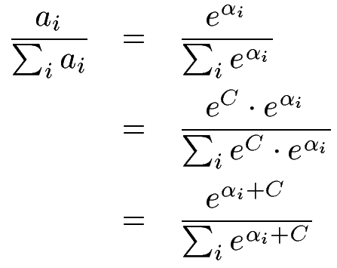

Recovering the Probabilities
Given:
Then for any constant C:
One suggestion: set C such that the greatest α_{i} is shifted to zero:
See https://stats.stackexchange.com/questions/105602/example-of-how-the-log-sum-exp-trick-works-in-naive-bayes?noredirect=1&lq=1

Slide 64
Recap
We defined a Bayes classifier but saw that it’s intractable to compute P(X₁,…,X_{n}|Y)
We then used the Naïve Bayes assumption – that everything is independent given the class label Y
A natural question: is there some happy compromise where we only assume that some features are conditionally independent?
  Stay Tuned…

Slide 65
Conclusions
Naïve Bayes is:
  Really easy to implement and often works well
  Often a good first thing to try
  Commonly used as a “punching bag” for smarter algorithms

Slide 66
Acknowledgements
http://www.cmpe.boun.edu.tr/~ethem/i2ml3e
https://users.cs.fiu.edu/~taoli/class/CAP4770-F10/class08.ppt

